Slide 1
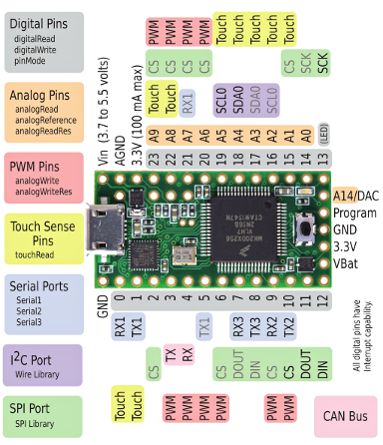
Teensy Interface
System Parameters
Modify Output Parameters
Output Variables Hash Table
Output Parameters Updated Event
triggers
“Fin 0 motion” | 3
“LED 0 brightness” | 1200
“Operation Mode” | 5
… | …
Update Output Parameters
Communication Protocol
Input Variables Hash Table
“Fin 0 accelerometer-x” | -254
“IR sensor 0 reading” | 1254
“Loop period” | 15
… | …
triggers
Update Input Parameters
Input Parameters Updated Event
Set New Sample Ready Flag

